Slide 1
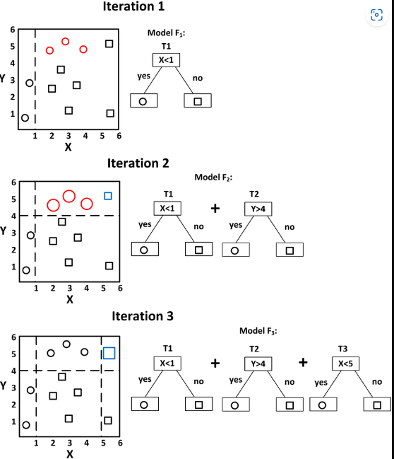
XG boost ( Gradient Boost)

Slide 2
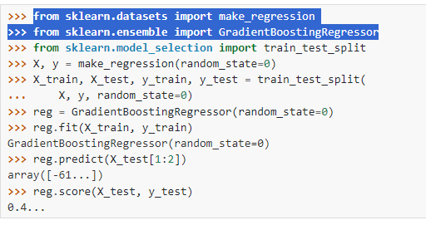

Slide 3
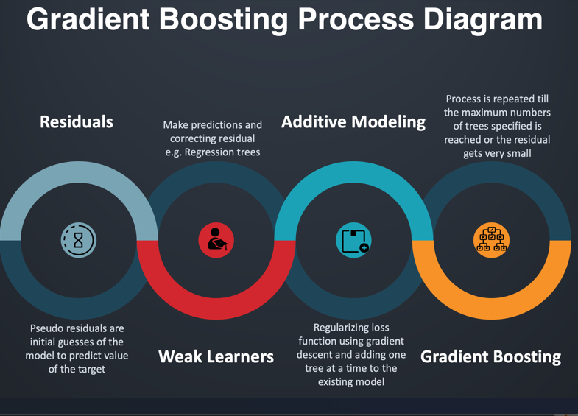

Slide 4
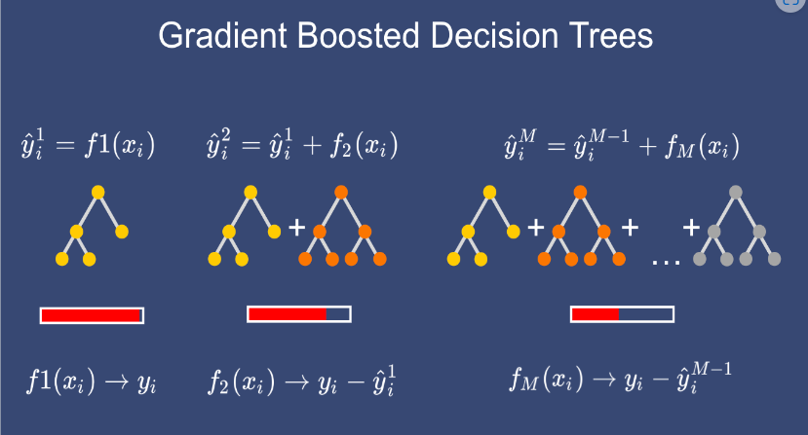

Slide 5
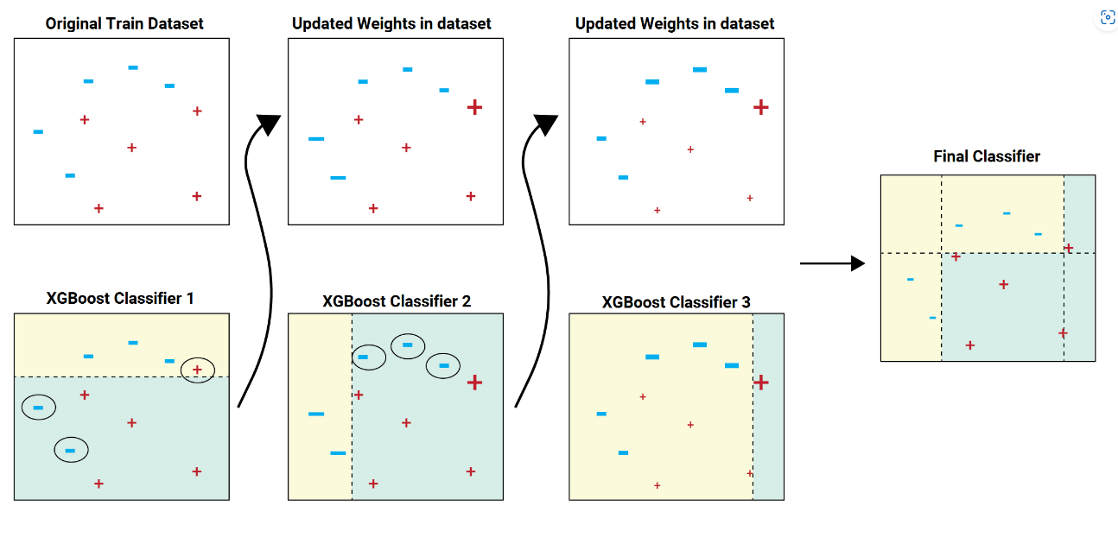

Slide 6
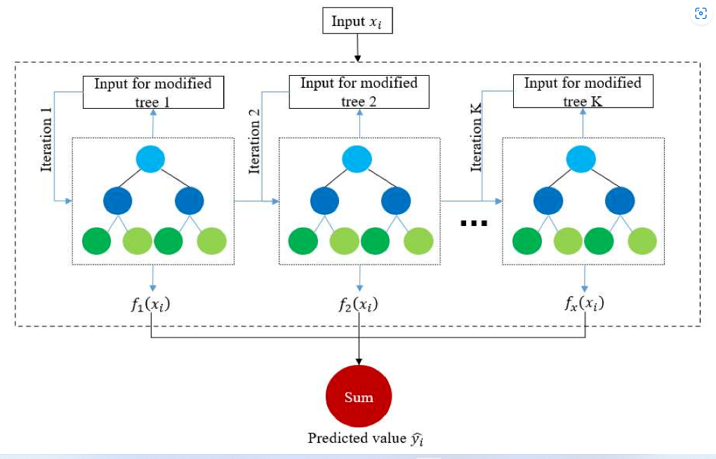

Slide 7
LG BOOSTING ALGORIHM

Slide 8
Parameter Tuning of LightBGM Model A few important parameters and their usage is listed below :
max_depth :
It sets a limit on the depth of tree. The default value is 20. It is effective in controlling over fitting.
categorical_feature :
It specifies the categorical feature used for training model.
bagging_fraction :
It specifies the fraction of data to be considered for each iteration.
num_iterations :
It specifies the number of iterations to be performed. The default value is 100.
num_leaves :
It specifies the number of leaves in a tree. It should be smaller than the square of max_depth.
max_bin :
It specifies the maximum number of bins to bucket the feature values.
min_data_in_bin :It specifies the minimum amount of data in one bin.
task : It specifies the task we wish to perform which is either train or prediction. The default entry is train. Another possible value for this parameter is prediction.
feature_fraction : It specifies the fraction of features to be considered in each iteration. The default value is one.

Slide 10
Advantages of LightBGM Model
LightBGM Algorithm has faster speed and higher accuracy
It has lower Memory usage
It has better accuracy
It supports parallel and distributed GPU learning
It is capable of handling large scale data

